Slide 1
DIGITAL PORTFOLIO :
STUDENT NAME: KETHESHWARAN.N
REGISTR NUMBER AND NMID : astvu20920924u09088
DEPARTMENT : BCA
COLLEGE AND UNIVERSITY : SHANMUGA INDUSTRIES ARTS AND SCIENCE COLLEGE/THIRUVALLUVAR UNIVERSITY

Slide 2
PROJECT TITLE :
DIGITAL PORTFOLIO : PAWFECT MEMORIES STUDIO

Slide 3
AGENDA :
1. Problem Statement.
2. Project Overview.
3. End Users.
4. Tools and Technologies.
5. Portfolio Design and Layout.
6. Features and Functionality.
7. Results and Screenshots.
8. Conclusion.
9. GitHub Links.

Slide 4
PROBLEM STATEMENT :
1. Pet owners lack organized ways to preserve special pet moments.
2. Existing platforms aren’t personalized or user-friendly.
3. Need for a digital portfolio showcasing professional services.

Slide 5
PROJECT OVERVIEW :
1. Digital portfolio for Pawfect Memories Studio.
2. Highlights pet photography, videography, and family moments.
3. Focus on clean, interactive, and visually appealing design.

Slide 6
END USERS :
1. Pet owners wanting professional photos/videos.
2. Families capturing memories with pets.
3. Anyone seeking high-quality, shareable content.

Slide 7
TOOLS AND TECHNOLOGIES :
1. HTML, CSS, JavaScript for front-end.
2. Responsive design for multiple devices.
3. Image/video optimization for fast loading.

Slide 8
PORTFOLIO DESIGN AND LAYOUT :
1. Simple, intuitive navigation.
2. Separate sections: photography, videography, family moments.
3. Emphasis on visuals to showcase quality.

Slide 9
FEATURES AND FUNCTIONALITY :
1. “Display media content professionally for clients.
2. “Contact Us” and social media links for engagement.
3. Mobile-friendly and responsive design.

Slide 10
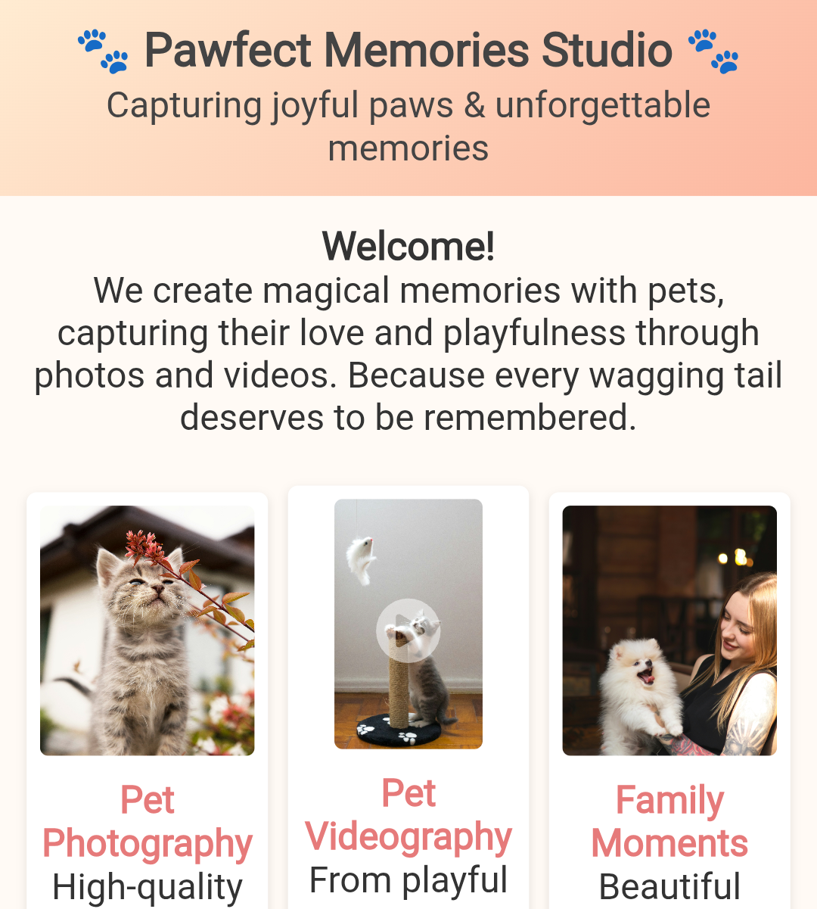
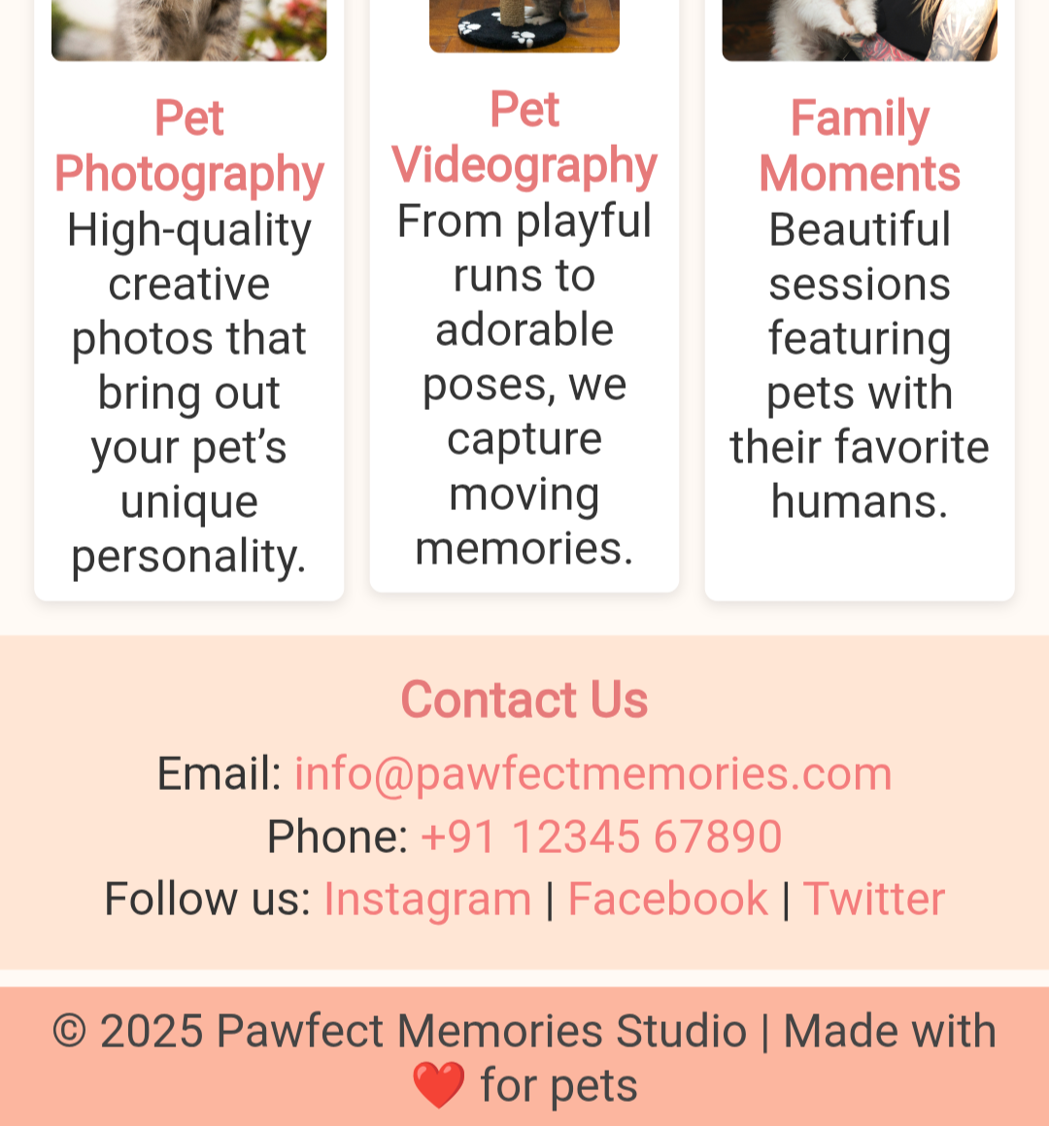
RESULTS AND SCREENSHOTS :

Slide 11
CONCLUSION :
1. Portfolio boosts visibility and credibility.
2. Easy platform for clients to explore and contact.
3. Professional showcase of services.

